Slide 1


Nanopublications for Biodiversity: Concept, Format, Implementation
v
Lyubomir Penev, Éamonn Ó Tuama, Viktor Senderov, Teodor Georgiev, Pavel Stoev
Pensoft Publishers & Bulgarian Academy of Sciences, Sofia, Bulgaria
TDWG 2016, La Fortuna, December 2016

Slide 2

This presentation will focus on
What is a nanopublication?
Anatomy of a nanopublication
Nanopublications in the context of biodiversity publishing
Proof of concept: Examples of biodiversity nanopublications
How to use nanopublications?

Slide 3
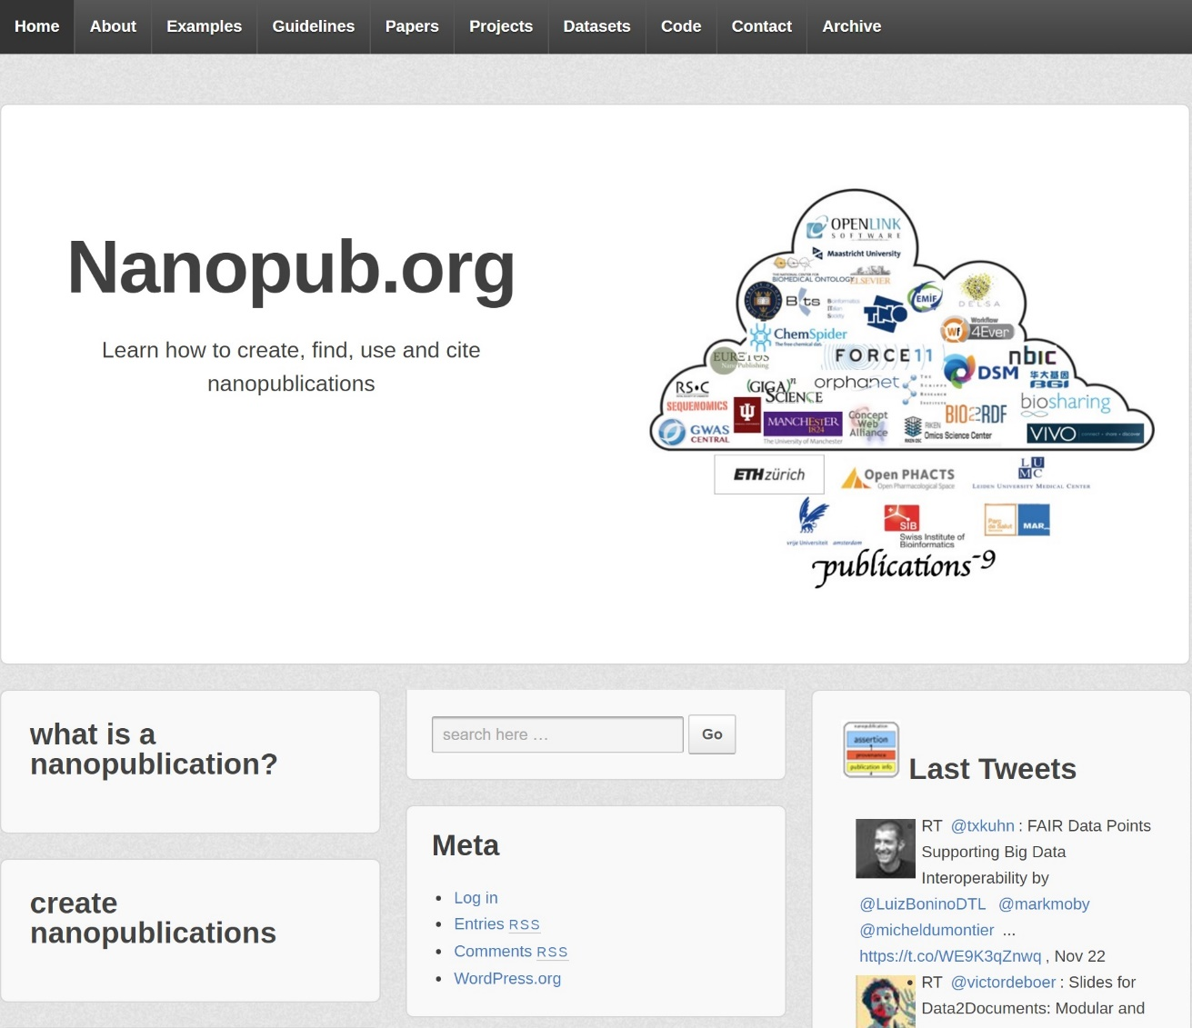
What is a nanopublication?
The smallest unit of publishable information: an assertion about anything that can be uniquely identified and attributed to its author.
Groth, Gibson, and Velterop (2010)
http://www.nanopub.org

Slide 4
Nanopublications
proposed as a complement to traditional scholarly research articles allowing the underlying data to be attributed and cited
providing an incentive to researchers to make their data available using machine-readable formats
supporting large scale integration and interoperability whilst being able to track the provenance of every contribution
can also function as independent standalone publications

Slide 5
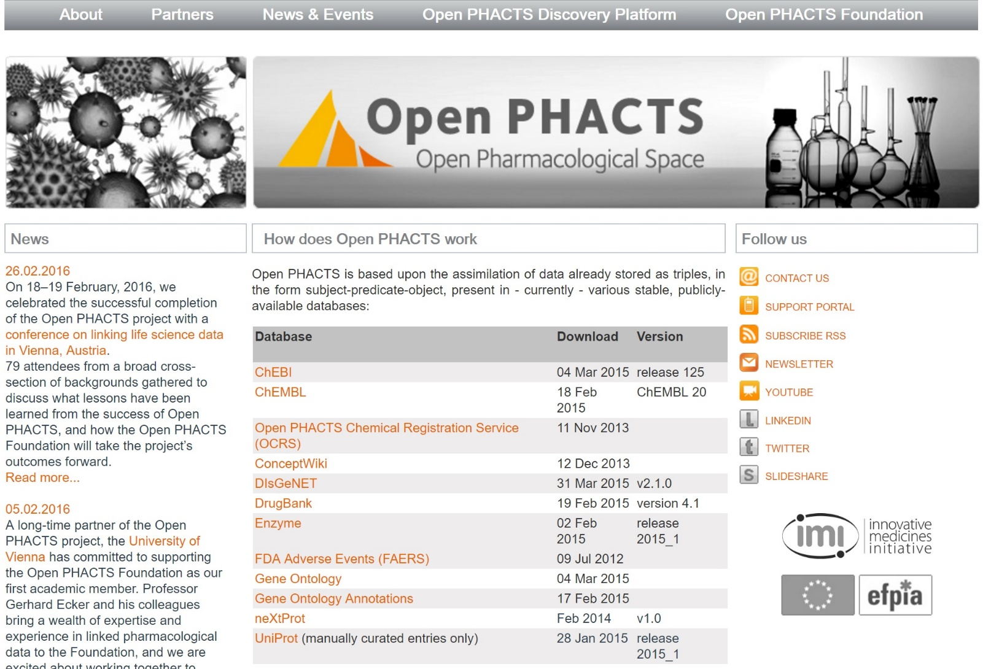
http://www.openphacts.org

Slide 6
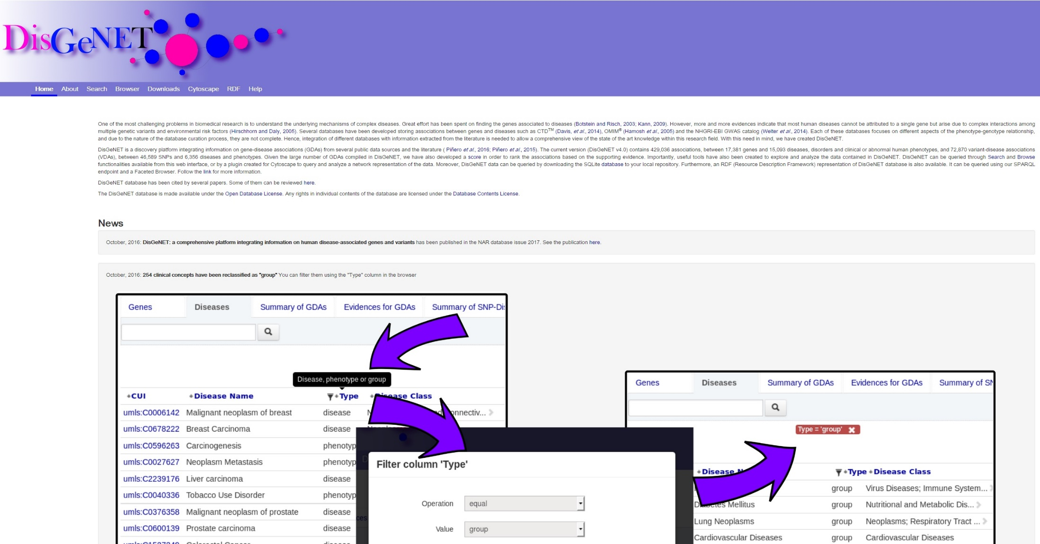
http://www.disgenet.org

Slide 7
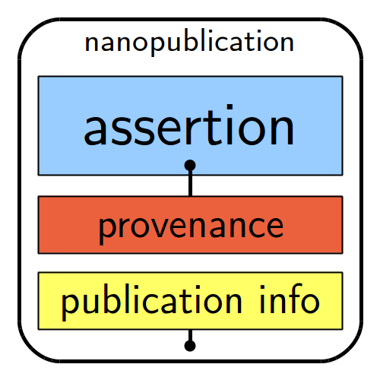
Anatomy of a nanopublication
Tree RDF named graphs
The assertion: a statement linking two concepts (subject and object) via a third concept (predicate).
The provenance: some metadata to provide context for the assertion.
The publication information: metadata about the actual nanopublication itself.
Credit: nanopub.org

Slide 8
Nanopublications in biodiversity
Biologically meaningful assertions about facts in biodiversity science
Machine-readable (RDF)
Expressed with the respective provenance and citation record
Validated by the nanopubs.org schema
Preserved and handled in a triple store

Slide 9
What’s the purpose?
For expressing & publishing single, scientifically valuable facts in machine-readable form with all necessary metadata
For mobilisation of small data, up to individual records
For atomization of scholarly article content into elementary scientific facts
For conversion of legacy and prospectively published literature into LOD
For linking to other nanopub stores or other kind of RDFs data in the LOD space
For extraction of new assertions about separate facts published in the LOD space

Slide 10
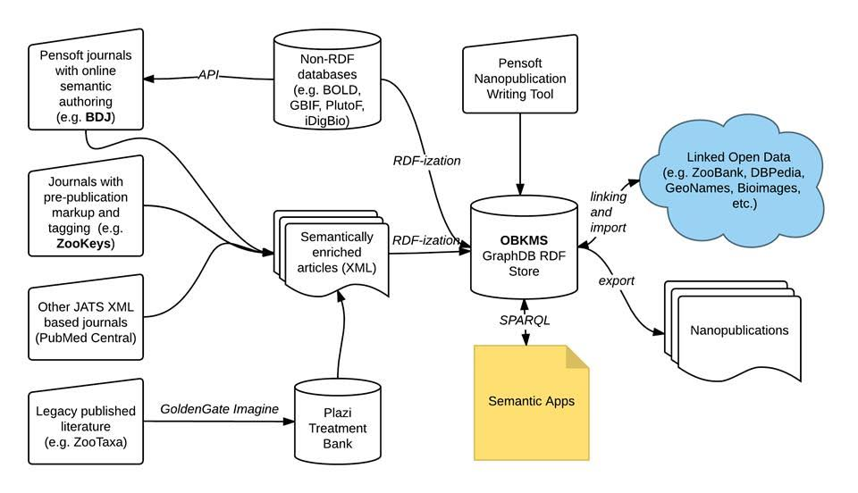

Nanopublications & OBKMS

Slide 11
Priority use cases
A new species described with locality
A new taxon concept
Renaming of a taxon/species
Significant extension of the range of a species (e.g., for an invasive species)
A new morphological or biological trait of a species
Monitoring data, i.e., species abundances subject to regular checks

Slide 12
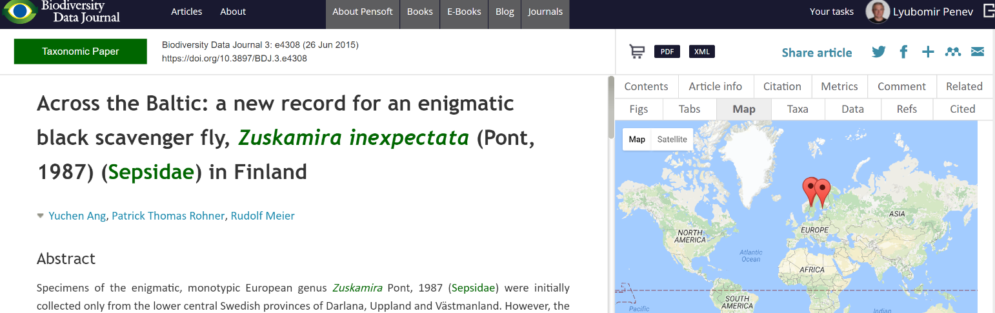
Use case 1: Occurrence record
Assertions in article A (longitudinal) range expansion of Zuskamira inexpectata (Pont, 1987) (Sepsidae) based on new localities in Southern Finland is reported, as well as new localities for Sweden.
The Nanopub Head
@prefix bdj: <http://bdj.pensoft.net/> .
@prefix dwc: <http://rs.tdwg.org/dwc/terms/> .
@prefix dsw: <http://purl.org/dsw/> .
@prefix dwciri: <http://rs.tdwg.org/dwc/iri/> .
@prefix np: <http://www.nanopub.org/nschema#> .
@prefix prov: <http://www.w3.org/ns/prov#> .
@prefix xsd: <http://www.w3.org/2001/XMLSchema#> .
@prefix foaf: <http://xmlns.com/foaf/0.99/> .
@prefix dcterms: <http://purl.org/dc/terms/> .
@prefix : <http://rdf.biosemantics.org/vocabularies/gene_disease_nanopub_example#> .
:NanoPub_1_Head {
bdj:pub1 a np:Nanopublication .
bdj:pub1 np:hasAssertion :NanoPub_1_Head_Assertion .
bdj:pub1 np:hasProvenance :NanoPub_1_Head_Provenance .
bdj:pub1 np:hasPublicationInfo :NanoPub_1_Head_PubInfo .

Slide 13
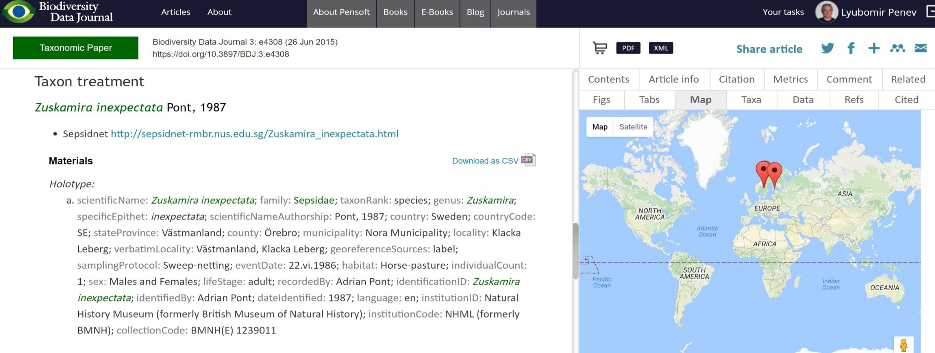
Use case 1: Occurrence record
Assertions in article modelled as nanopublication
_:organism1 dsw:hasOccurrence _:occurrence1 , _:occurrence2 . _:organism1 dsw:hasIdentification _:identification1 , _:identification2 . _:occurrence1 dsw:atEvent _:event1 . _:occurrence2 dsw:atEvent _:event2 . _:occurrence1 dwciri:recordedBy _:agent1 , _:agent2 , _:agent3 . _:occurrence2 dwciri:recordedBy _:agent1 . _:identification1 dwciri:toTaxon _:taxon1 . _:identification2 dwciri:toTaxon _:taxon1 .

Slide 14

Use case 1: Occurrence record
The Provenance
:NanoPub_1_Head_Provenance {
:NanoPub_1_Head_Assertion prov:generatedAtTime "2015-06-26"^^xsd:dateTime .
:NanoPub_1_Head__Assertion prov:hadPrimarySource "doi: 10.3897/BDJ.3.e4308" .
The Publication Information
:NanoPub_1_Head_PubInfo {
this: prov:generatedAtTime "2016-10-10T12:30:00Z"^^xsd:dateTime ;
prov:wasAttributedTo sub:_4 .

Slide 15
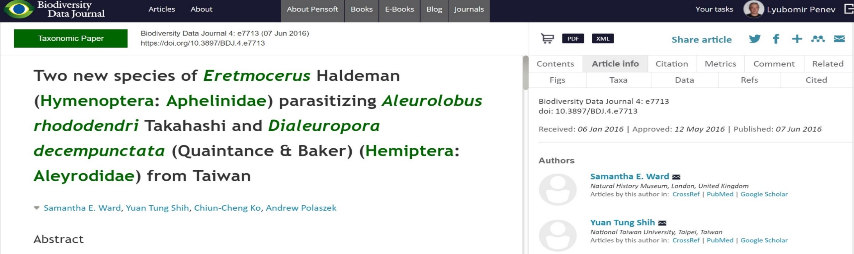
Use case 2: Host-Parasite Relationship
Assertion in article
Two new species, Eretmocerus garrywardi Ward sp. nov. and Eretmocerusliangyihchoui Shih sp. nov. found parasitizing Aleurolobus rhododendri Takahashi and Dialeuropora decempunctata respectively, are described
Assertion modelled as nanopublication
_:organism1 a dwc:Organism , caro:CARO_0010004 ; # organism in Common Anatomy Reference Ontology dsw:hasIdentification _:identification1 ; dsw:hasOccurrence _:occurrence1 . _:species-interaction1 a go:GO_0044419 ; # "interspecies interaction with other organisms" ro:RO_0000057 _:organism1 , _:organism3 . # RO_0000057 expresses "has part" relationship A parasite is related to its host using the "parasite-of" property (RO_0002444) from the Relation Ontology: _:organism1 ro:RO_0002444 _:organism3 . # "parasite-of" .

Slide 16
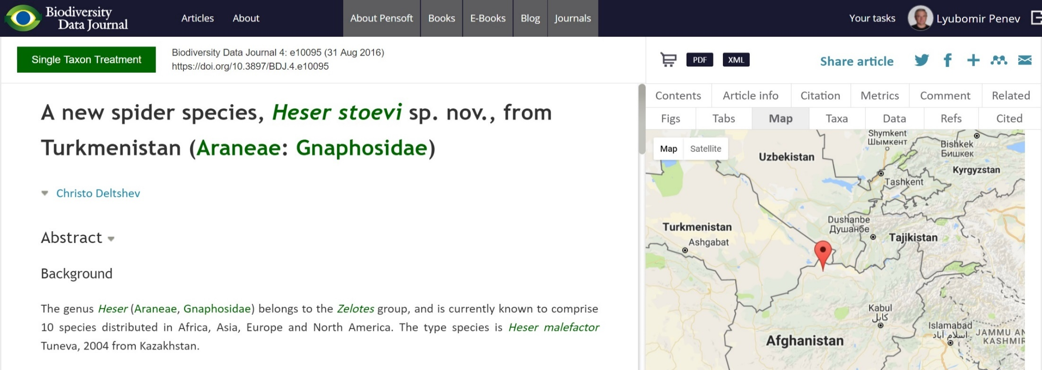
Use case 3: New species
Assertion modelled as nanopublication
_:organism1 dsw:hasOccurrence _:occurrence1 . _:organism1 dsw:hasIdentification _:identification1 . _:occurrence1 dsw:atEvent _:event1 . _:occurrence1 dwciri:recordedBy _:agent1 . _:identification1 dwciri:toTaxon _:taxon1 . _:occurrence1 dsw:hasEvidence _:material1 . _:taxon1 dwc:scientificName _:name1 . _:occurrence1 dsw:hasEvidence _:material1 . .

Slide 17
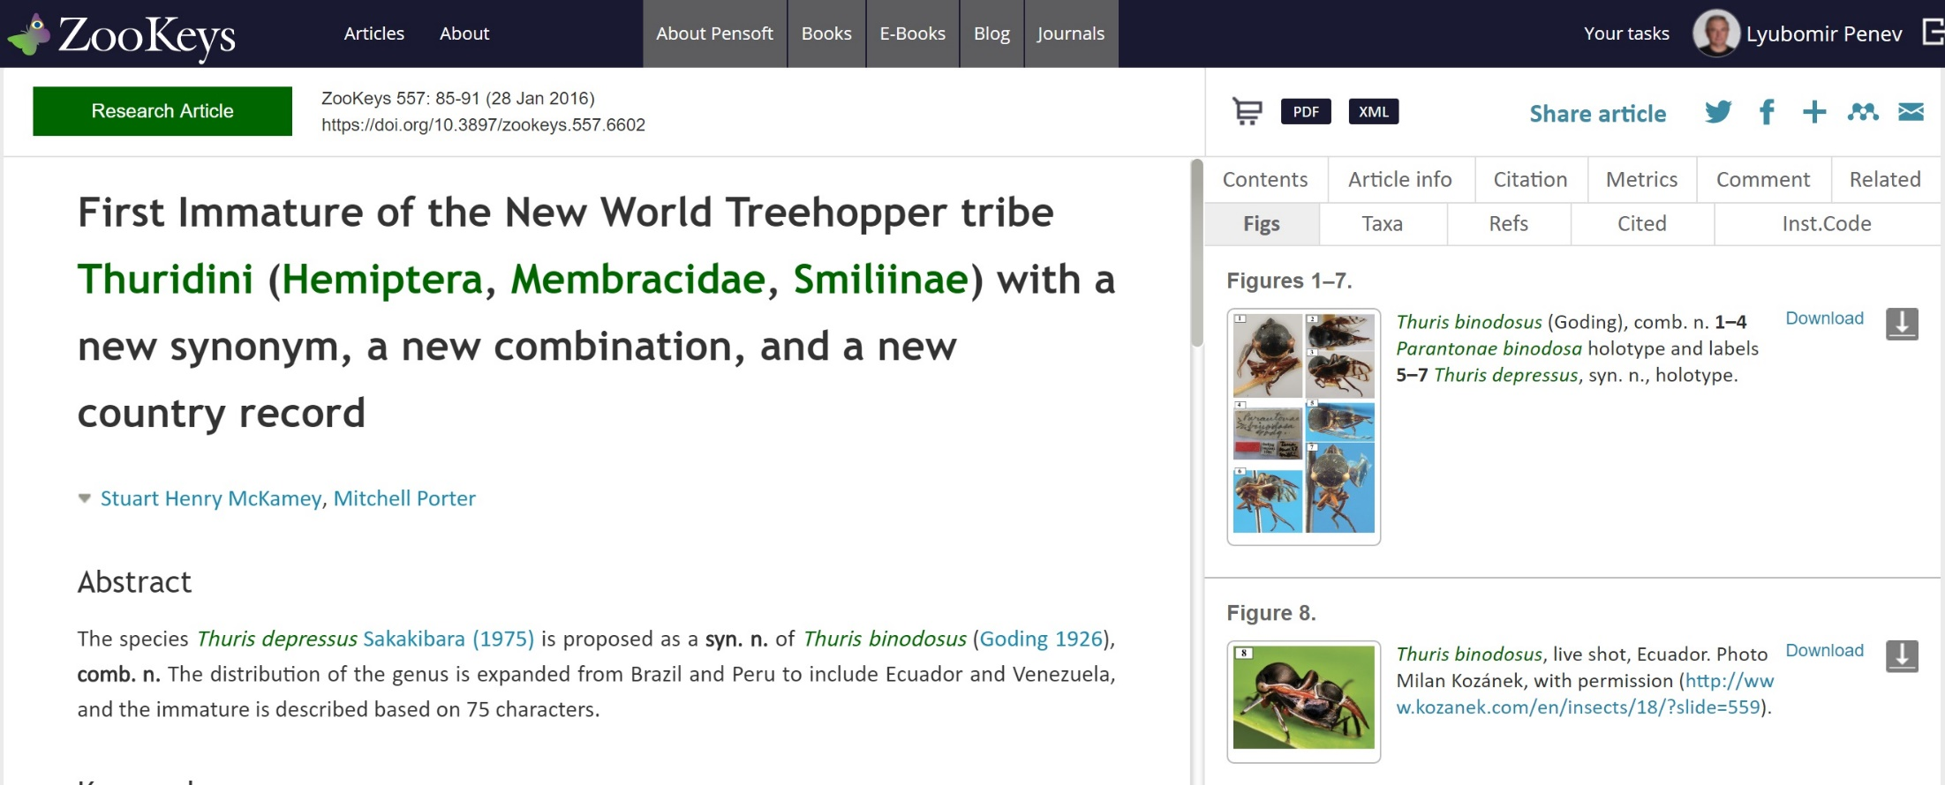
Use case 4: Synonyms, new combinations
Assertion modelled as nanopublication
"Thuris depressus Sakakibara (1975)" is_syn_of "Thuris binodosus (Goding 1926)"
"Thuris binodosus (Goding 1926)" is_comb.new_of _:comb_new1
_:comb_new1 contains "Parantonae binodosa Goding 1926"
_:comb_new1 contains "Thuris depressus Sakakibara 1975"

Slide 18
Who would be using nanopubs?
Triple stores can repackage/export part of their content as nanopubs
Scientists can publish new facts and assertions via user interface
Aggregators can harvest nanopubs and extract newly published facts in their domains (CoL for nomenclatural changes; GBIF for occurrence records, etc.)
Annotations of online data records could also be published as nanopublications (see Rod Page’s iPhylo blog)
Consumed by the Biodiversity Knowledge Graph

Slide 19
How to create nanopublications?
Extracted from semantically enhanced XMLs of published artciles
Generated from relational databases
Re-packaging of content in triple stores
De novo standalone publication via user interface

Slide 20
Nanoabstracts
A set of nanopublications reflecting the most important asserions in an article
Nanoabstracts can be created by the authors via user-friendly interface
@Phenopack may also well serve as a conceptual framework for nanoabstracts

Slide 21



I Open Science!
PLAZI

